Slide 1
Tools for group work
Notes:
This provides a short overview over some useful tools for group work.
Please add any more tools that you use and enjoy!
Can be substituted if time is short by providing the written information online

Slide 2
Tools for collaboration
Where to work
Lending equipment
How to
manage projects

Slide 4
Tools für Kollaborationen
Etherpad: https://etherpad.leuphana.de - simple text editor
Cryptpad*: https://pad.leuphana.de/- text editor with several functions
  Instructions at https://docs.cryptpad.fr/de/user_guide/index.html
  Crypt-Drive
Trello: https://academiccloud.de
Academic Cloud*: https://academiccloud.de
*Leuphana-associated
Notes:
I suggest you open the websites, briefly explain how they work
Etherpad: simple text editor, in which is written synchronously – author is recognizable by different colors - good for protocols - can be exported to PDFs or DOCs
Cryptpad: especially for Leuphana, should replace Etherpad - text editor that makes communication immediate, works synchronously + asynchronously - perfect for collaboration
Recommendation: create an account, so common calendars can be created and documents can be shared; teams are also possible
Document types: tables, rich text (equivalent to Etherpad), to-do list (= Kanban), code, forms, whiteboards
this also includes Crypt-Drive to store documents + media
Trello boards: management of work steps and progress in a workspace
Academic Cloud: Cloud service for Lower Saxony, for sharing and editing documents (Sync & Share); Word documents + Presos can thus be edited directly in the cloud without downloading them, also simultaneously with others
Access directly via Leuphana account
more secure than Google Drive, as data is stored in Lower Saxony
extended with video conference "Meet" - not limited to 40min like Zoom

Slide 5
Where to work
Group study rooms in the library & central building
Room search via myStudy
other rooms on the campus
Video conferencing
  Zoom
  Meet
  Big Blue Button
Notes:
if you want to meet on campus, there are several ways to find a suitable location
Group study rooms in the library and central building:
3 rooms, different sizes and technical equipment
Reservable via MyStudy, but also usable without reservation if free
Reservation up to 7 days in advance, for 3h p.p. and day
Show booking: Resources > Book Resource > Group Study Room
if occupied, then simply search for free rooms on campus
Resources > Search for rooms > Search for free rooms, set filter if necessary
besides, it is always possible to meet (outside the main hours) in the refectory, in summer on the refectory lawn, or in Plan B
Video conferencing
Zoom: 40min limited
Big Blue Button
alternative is "Meet", as already mentioned belonging to the Academic Cloud; based on BigBlueBotton; usable via browser
Jitsi

Slide 6

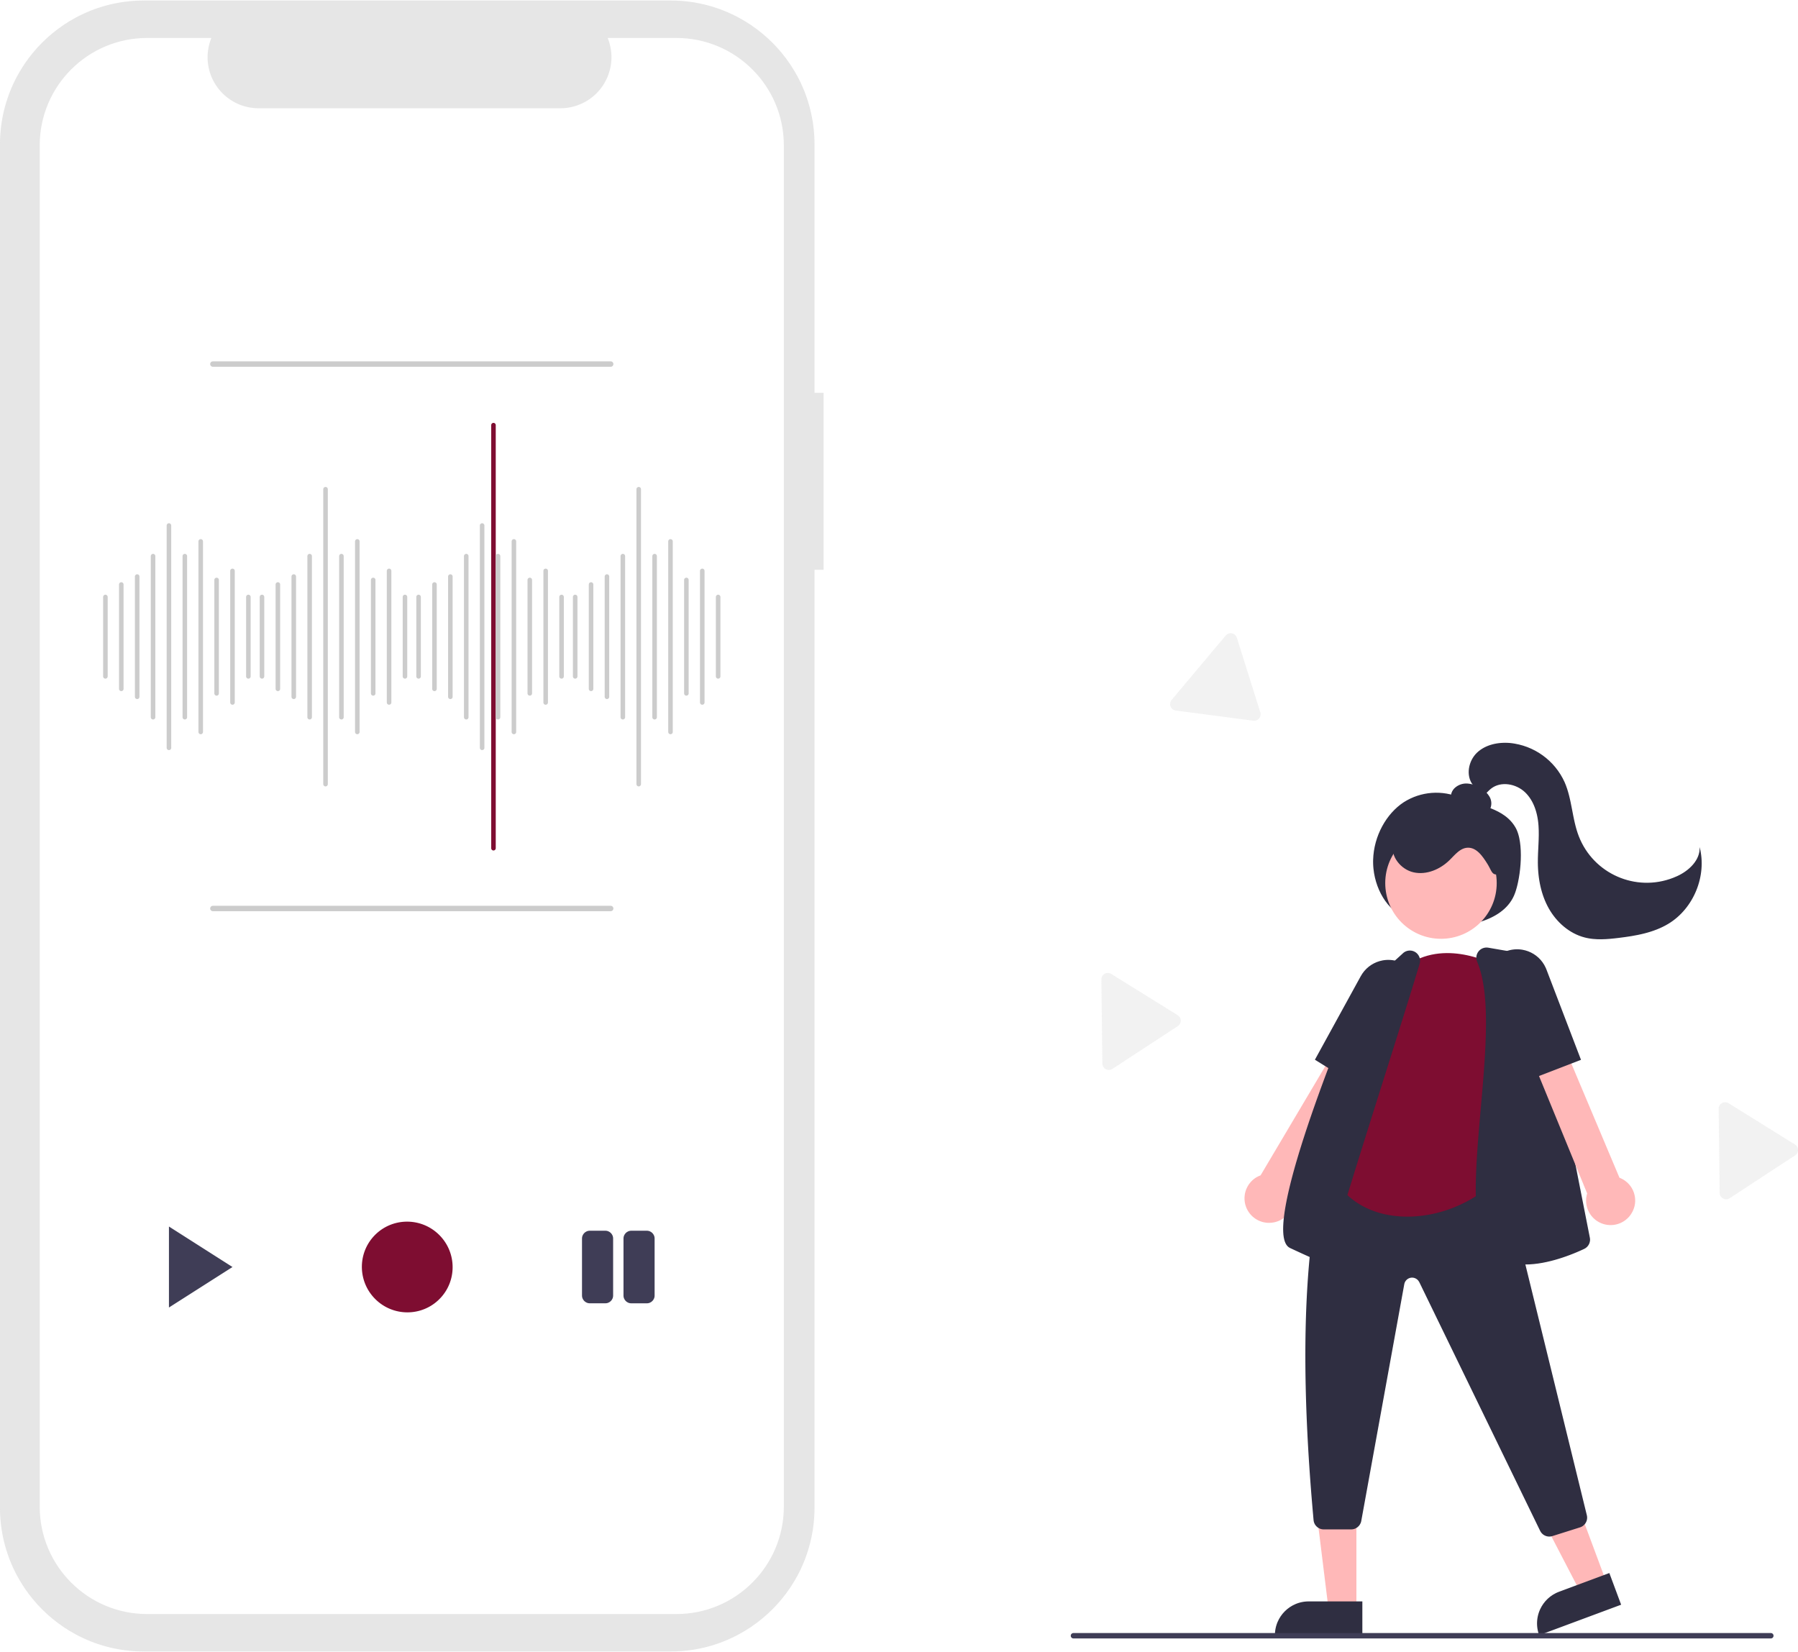
Lending equipment
Camcorder, sound equipment, editing suites → MIZ, Building 7
Recording equipment (audio, video), digital cameras, projectors → Equipment lending, Building 7
Recording equipment, transcription software → LinA-Lab, Building 1
Notes:
if you want to deliver more than just a PowerPoint presentation for this or later projects, Leuphana provides several resources.
especially for video productions the computer and media center has camcorders, sound equipment and software, Geb.7
for all other equipment, via beamers, laptops, cameras, recording devices): Equipment lending, building 7
only for seminar purposes, with lending card and reservation
especially for qualitative research (interviews, field observations): LinA-Lab, Building 5, with everything needed for transcriptions and field soundings.

